Slide 1
Communicating key messages; why bother?

Slide 2
Kevin Stewart
Royal College of Physicians since 2011
Safety Thermometer team, Department of Health, London 2010/11
Health Foundation Quality Improvement Fellow, Institute for Healthcare Improvement, Boston, USA 2009/10*
Masters in Public Health, Harvard, 2009/11
Medical Director (CMO), Winchester & Eastleigh NHS Trust, 2005/09
*Health Foundation funded
Notes:
2

Slide 3
Why bother?

Slide 4
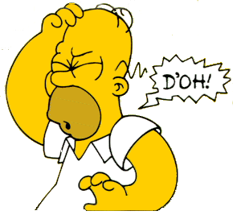
Why bother?
To improve care for patients!

Slide 5
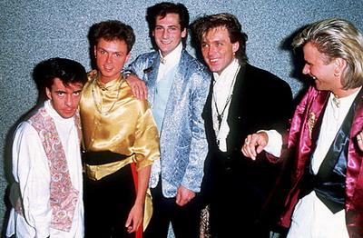
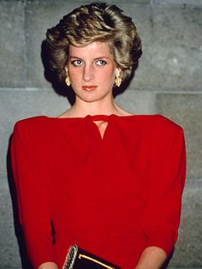
Where have we come from?

Slide 6
Early clinical audits and enquiries…
Professionally (medically) led and run
Small scale, pen & paper exercises
Unsophisticated methodology
The only “audience” was medical
Mechanisms for change relied on feeding results back to individual clinical teams or on one-off national reports

Slide 7
What’s changed?
A multi-million pound investment by the NHS
The complexity of patient care and clinical practice
Scientific methodology
Public attitudes and expectations
Professional attitudes and expectations
IT and the internet
Twitter, Facebook etc

Slide 8
Those able to influence patient care are varied and multiple…
Policymakers
Politicians
Local NHS leaders; CEOs etc
Press
Patients
Public
Professionals & their teams
Regulators
Commissioners
Improving
patient
care

Slide 9
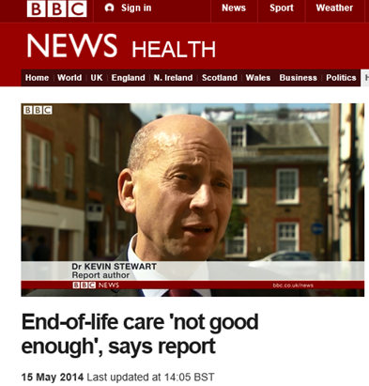
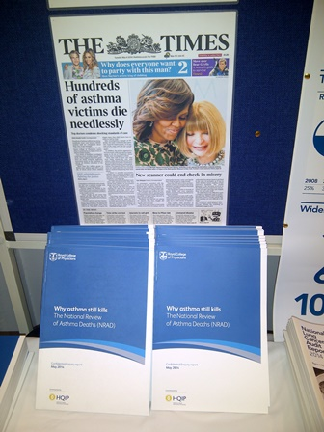
So outputs have to be varied and multiple…

Slide 10
Common myths
A compelling case will inevitably attract additional resources
Improvement will happen if;
We just show people the data
NHSE, HQIP, CEOs, the Colleges etc say it should
We attach money to it
We attach penalties to not doing it

Slide 11
More myths
CEOs/policymakers/politicians are just interested in the money
The press are only interested in bad news
The press are out to get us
Clinical experts intuitively know how to improve their own services
Those who can write research papers can also write other stuff

Slide 12
Communicating messages to clinicians

Slide 13
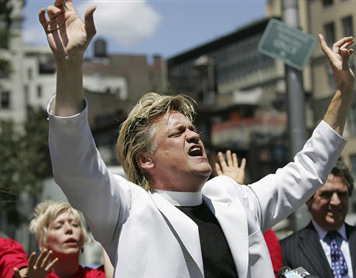
Communicating messages to clinicians; preaching to the choir?

Slide 14
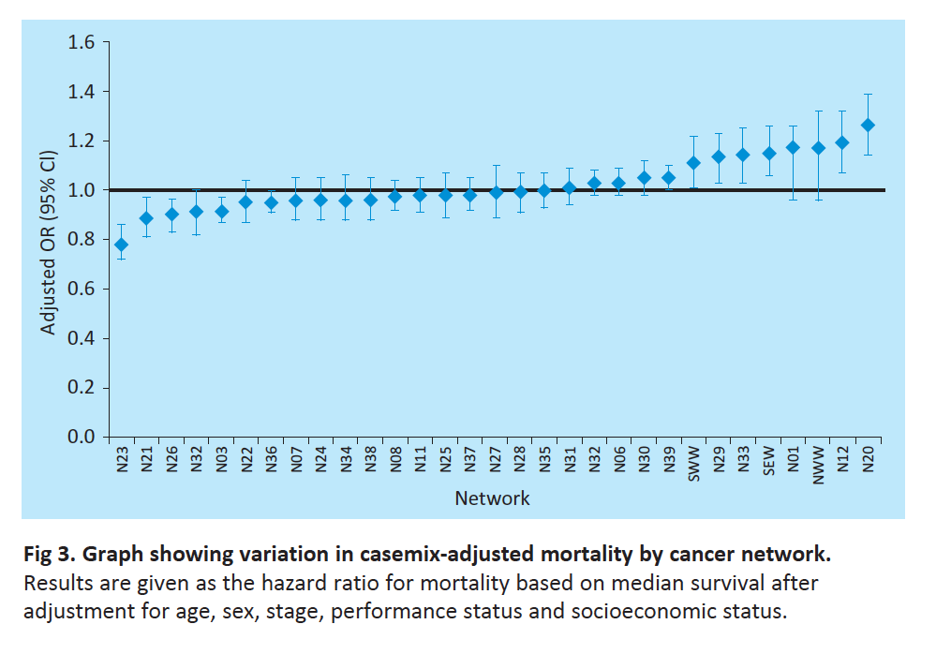
2013 national lung cancer audit

Slide 15
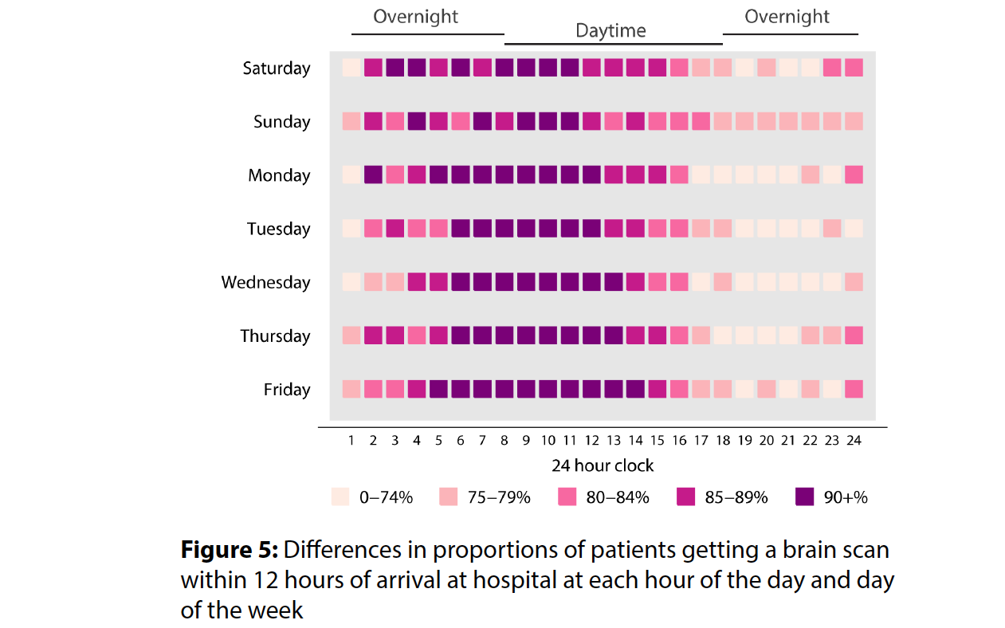
2013/4 stroke audit

Slide 16
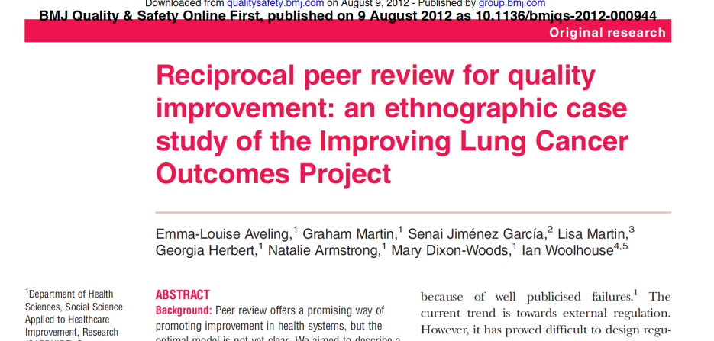
Link it to quality improvement

Slide 17
Politicians, policymakers, NHS leaders, CEOs, MDs, Trust Boards

Slide 18
Politicians & policymakers have..
Very limited time
Numerous competing pressures
Lots of people like us trying to get their attention
(Probably) an intrinsic suspicion of Colleges & professional bodies
An enhanced sensitivity to the press, public opinion, current news and priorities

Slide 19
CEOs, MDs, Trust Boards have…
Very limited time
Numerous competing pressures
Lots of people like us trying to get their attention
(Probably) an intrinsic suspicion of Colleges & professional bodies
Sensitivity to local issues
A fear of negative press, especially locally

Slide 20
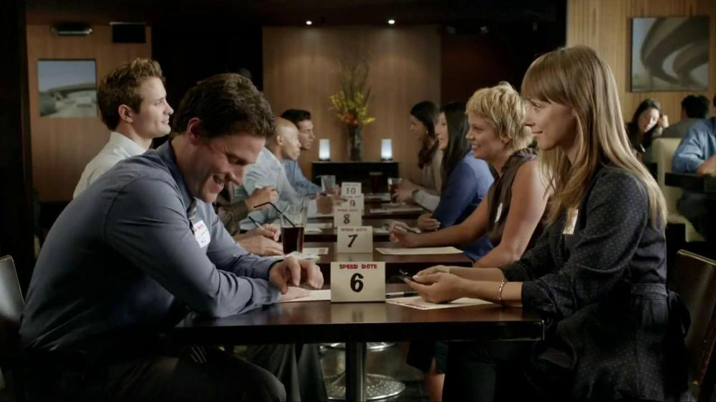
So they need…..

Slide 21
So they need…..
Bullet point headlines
An interpretation of “what this means” about the service in lay terms
An indication of where we stand in comparison to peers
Examples of good practice internally and externally
Offers of more detail or expert comment

Slide 22
The press?

Slide 23
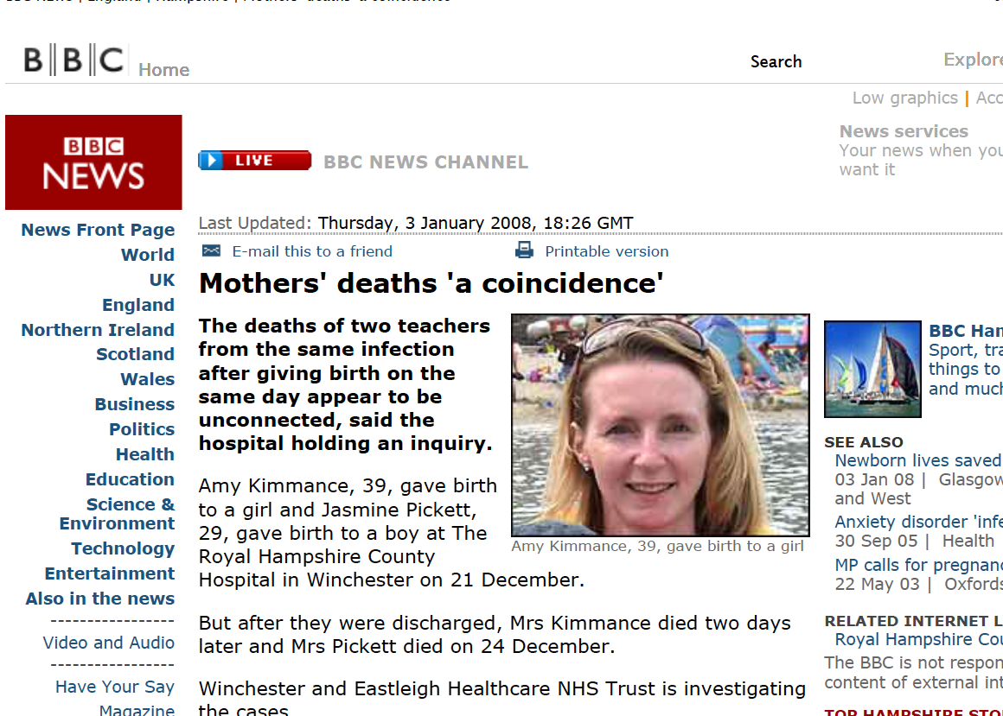
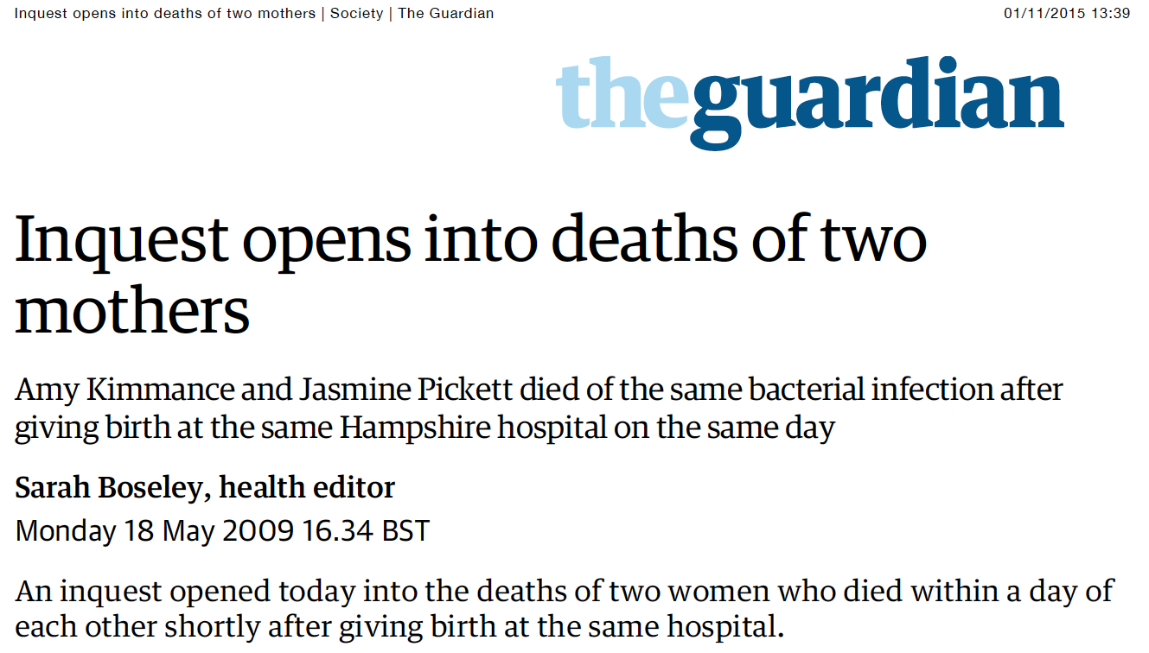

Slide 24
The press
Most journalists are good, hardworking people trying to do the right thing
Their perspective, pressures and timescales are very different from ours
They assume that vested interests (that’s us!) are trying to hide something from them
They can be a powerful vehicle for getting you message across

Slide 25
The press
Their communication style (headline, sub-headline, detail) is almost exactly the opposite of a traditional clinical one
Their deadlines are very tight
They like human stories to put around reports
Social media gets their attention as does HSJ, BMJ, Nursing Times, local papers etc.

Slide 26
Suggestions for dealing with the press
Get media training
Know who your strongest performers will be;
Verbal, visual, print
Be proactive
Ready-made press releases
Twitter
Provide human (patient and professional) stories
Provide them with good news stories

Slide 27
Suggestions for dealing with the press
Have 3 key messages; lead with these
Use the right phrases (“I have 3 key messages”, “as a doctor…”)
Use numbers sparingly and present them in an easily understood fashion
Consider getting a professional writer to help

Slide 28
Summary
For maximum impact our work needs to reach a range of audiences
One size does not fit all; use different styles and techniques for different groups
Consider getting professional help
Media training
Professional writers
Social media experts

Slide 29
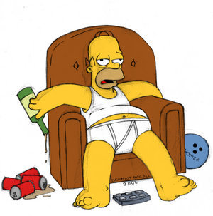
E mail me for slides and references
Kevin.stewart@rcplondon.ac.uk

